Slide 1
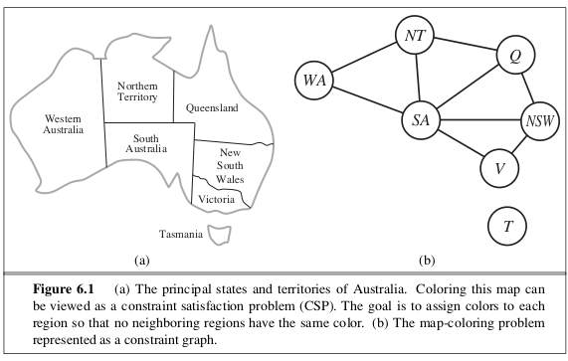
Map Coloring Problem
using Forward Checking and MRV Heuristic
A Constraint Satisfaction Problem (CSP) Approach
GROUP MEMBERS
GHULAM MUSTAFA
DEEPAK
SYED AHSAN SHAH

Slide 2



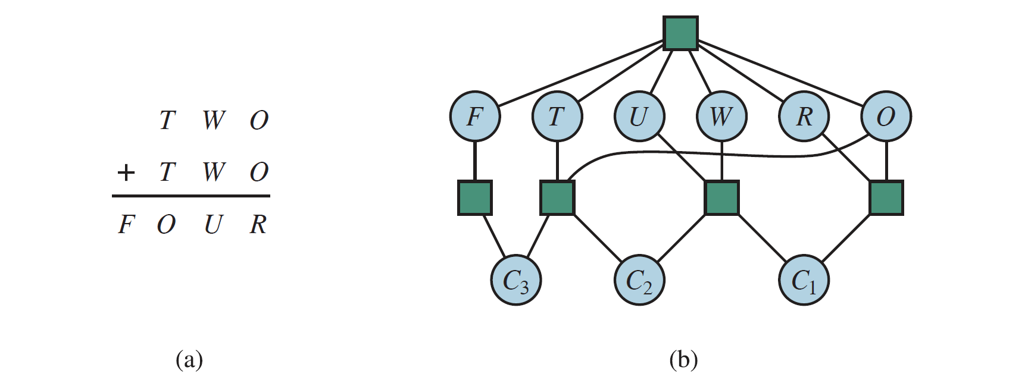


Introduction to CSP
Definition A CSP is defined by: Variables with possible values (domains) Constraints that restrict simultaneous values
CSP Components
Sudoku
N-Queens
Map Coloring
Fill grid with numbers 1-9
Place N queens on N×N board
Color regions with constraints
Goal
Find an assignment that satisfies all constraints
Relevance
Foundation of many AI problem-solving methods

Slide 3
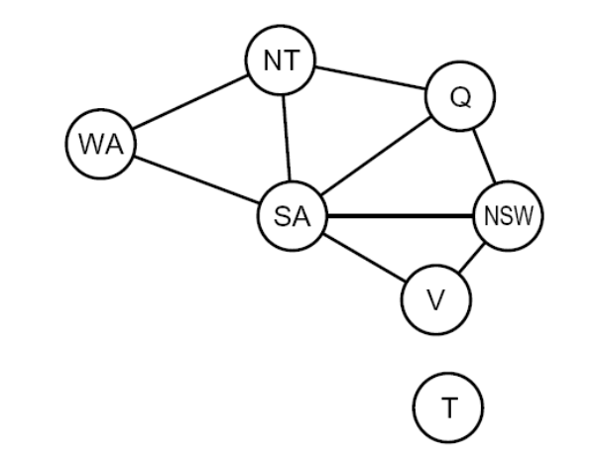








The Map Coloring Problem
Definition Assign colors to regions on a map so that no two adjacent regions share the same color
Australia Map Coloring Example
Variables
Domains
Regions or states
Set of available colors
{Red, Green, Blue}
Constraints
Goal
Adjacent regions ≠ same color
Minimize number of colors
Applications
GIS
Scheduling
Compilers
Geographic Information Systems
Resource allocation
Register allocation

Slide 4




CSP Formulation
Variables
Domains
Map regions (A, B, C, D, ...)
Possible colors
{Red, Green, Blue, Yellow}
Search Space Complexity
Constraints
Example
Adjacent regions must not share the same color
WA ≠ NT, SA
NT ≠ SA, Q
SA ≠ Q, NSW, V
Objective Minimize conflicts and find a valid coloring assignment
3 regions
3 colors
27 solutions
5 regions
3 colors
243 solutions
7 regions
3 colors
2,187 solutions
10 regions
3 colors
59,049 solutions
Challenge Search space increases rapidly as the number of regions and colors grows

Slide 5
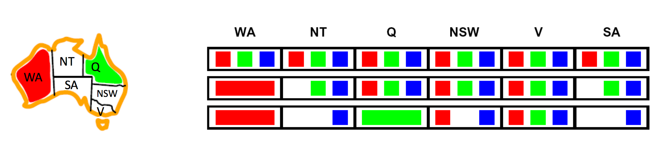





Forward Checking Algorithm
Forward Checking Process
Concept Optimization for backtracking that checks ahead to eliminate invalid choices before they cause conflicts
Assign WA = Red
Working
1
Assign a color to a region
↓
2
Remove that color from the domain of adjacent regions
Remove Red from NT, SA domains
3
If a neighbor's domain becomes empty, backtrack
↓
Check if any domain is empty
Advantages
↓
Continue or Backtrack
Detects dead ends early
Reduces unnecessary search
Improves efficiency in CSPs

Slide 6
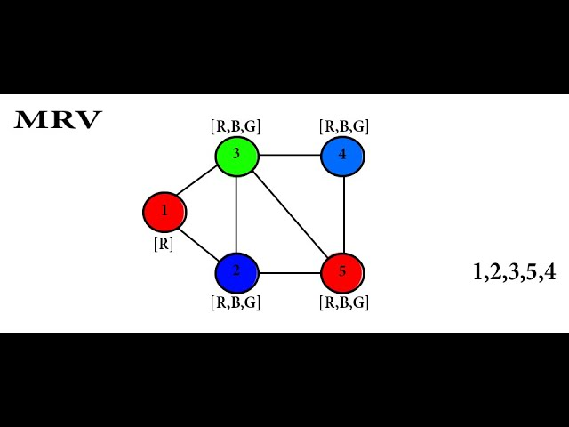





MRV (Minimum Remaining Values) Heuristic
MRV Heuristic in Action
Definition Chooses the variable with the fewest legal remaining values to assign next
Why Use It
Identifies the most constrained variable early
Minimizes backtracking by tackling difficult decisions first
Reduces search space significantly
Example
1. Select variable with smallest domain
VS
Region A
Region B
2. Apply Forward Checking to prune neighbor domains
Domain: {Red, Blue, Green}
Domain: {Red}
R
B
G
R
3. Repeat until all variables are assigned
Choose Region B first (MRV heuristic)

Slide 7
Backtracking
+ MRV
+ Forward Checking
+ Both
Combined Benefit MRV + Forward Checking = Faster and Smarter Search
100%
40%
10%
25%

Slide 8
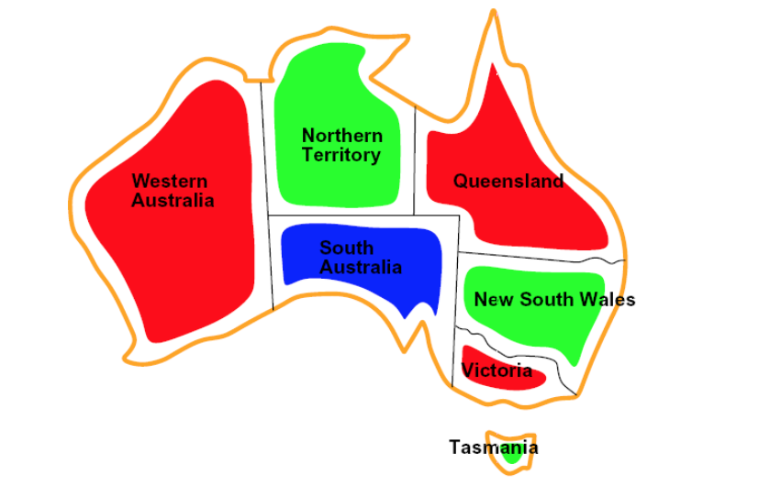







Dataset and Implementation
Sample Output
Dataset Source Synthetic or real map dataset (e.g., regions of Pakistan or Australian map)
Tools Used
Python
NetworkX
Core implementation
Graph representation
Matplotlib
CSV/JSON
Visualization
Data storage
Implementation Steps
1
Represent map as graph (nodes = regions, edges = borders)
No two adjacent regions share the same color
3
Apply MRV to select variable with smallest domain
Use Forward Checking for constraint propagation
4
Visualize colored map with Matplotlib

Slide 9

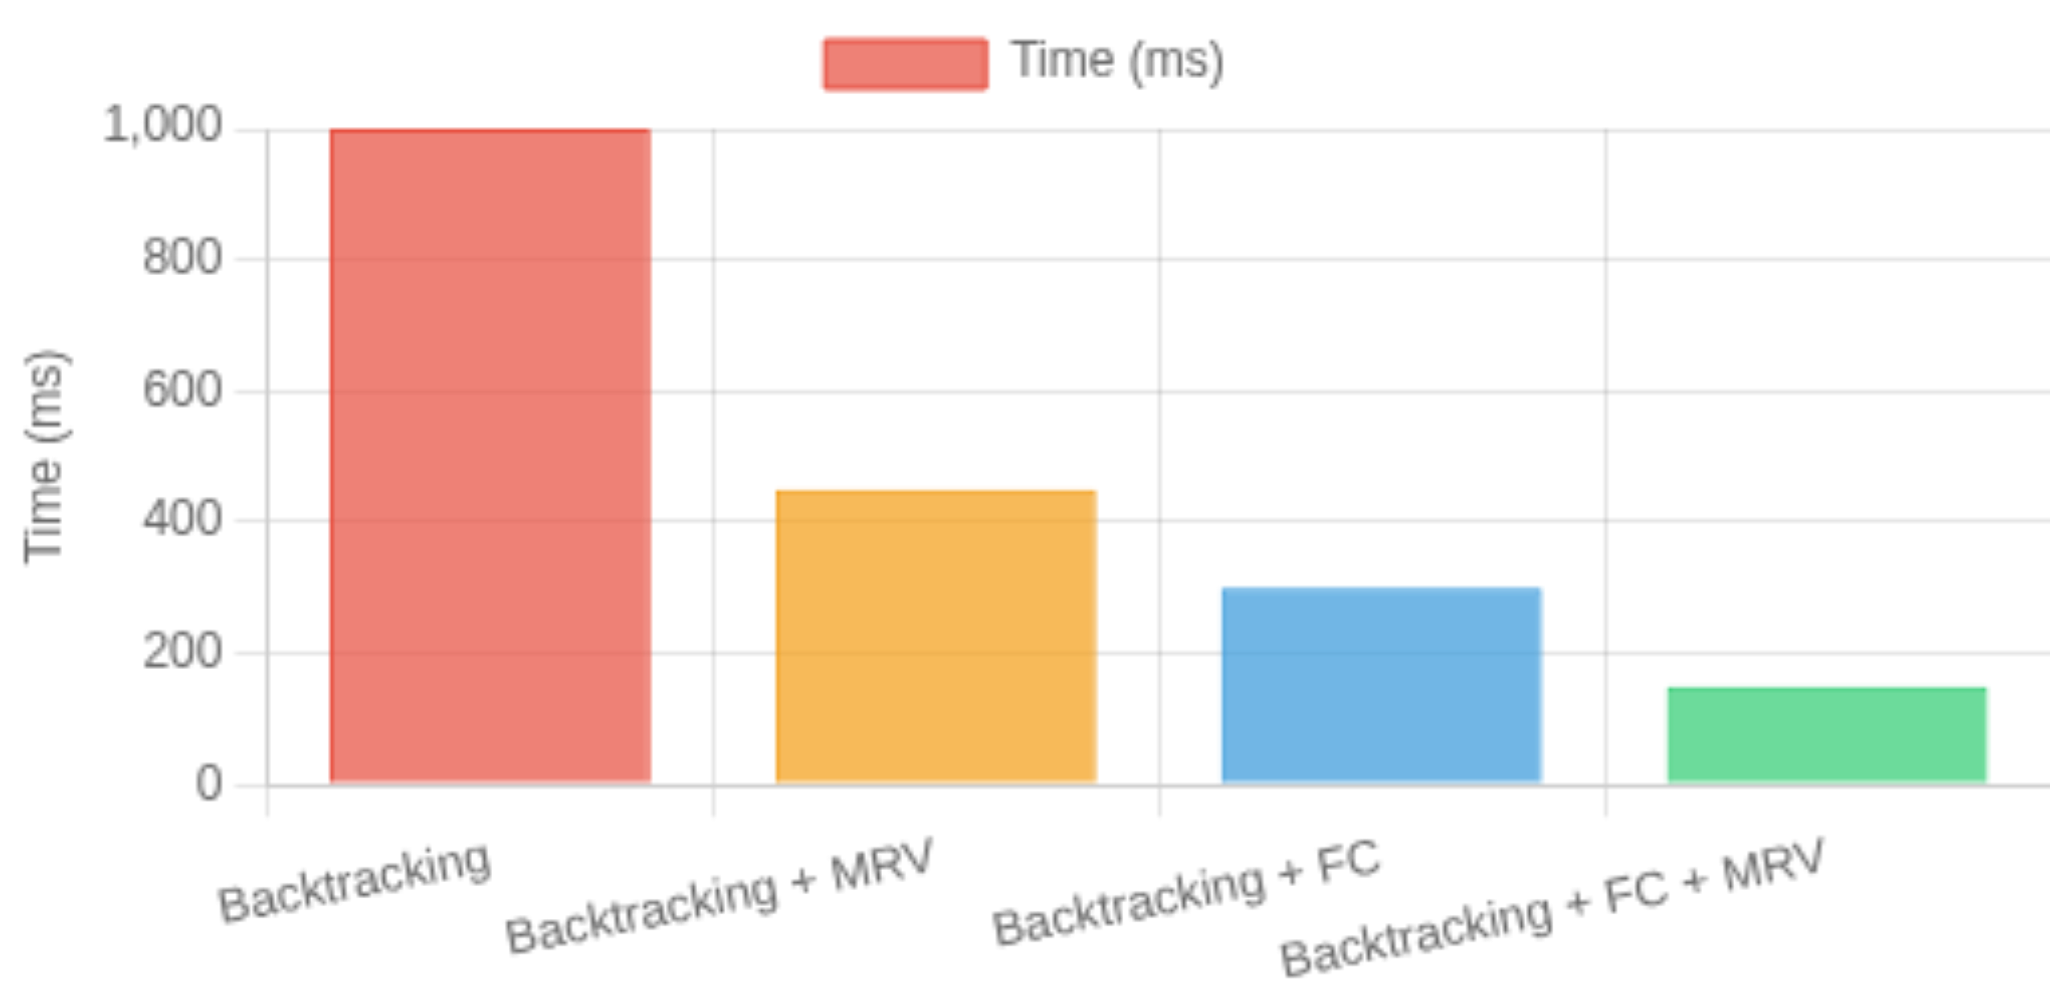


Results and Analysis
Performance Metrics
Algorithm Comparison
Backtracking Only
FC + MRV
90%
75%
85%
Speed:
Reduced Backtracking
Fewer Conflicts
Time Saved
Speed:

Slide 10
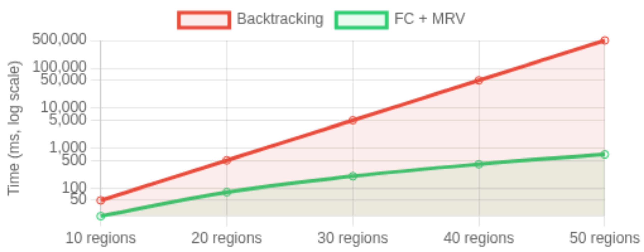
Key Observation The combined algorithm significantly reduces computation time and increases efficiency by: Selecting optimal variables first (MRV) Pruning search space early (Forward Checking) Minimizing dead-end exploration
Time Complexity Comparison
Conclusion Forward Checking + MRV outperforms naive backtracking for CSP-based map coloring, especially for: Large maps with many regions Problems with limited color domains Complex adjacency constraints

Slide 11









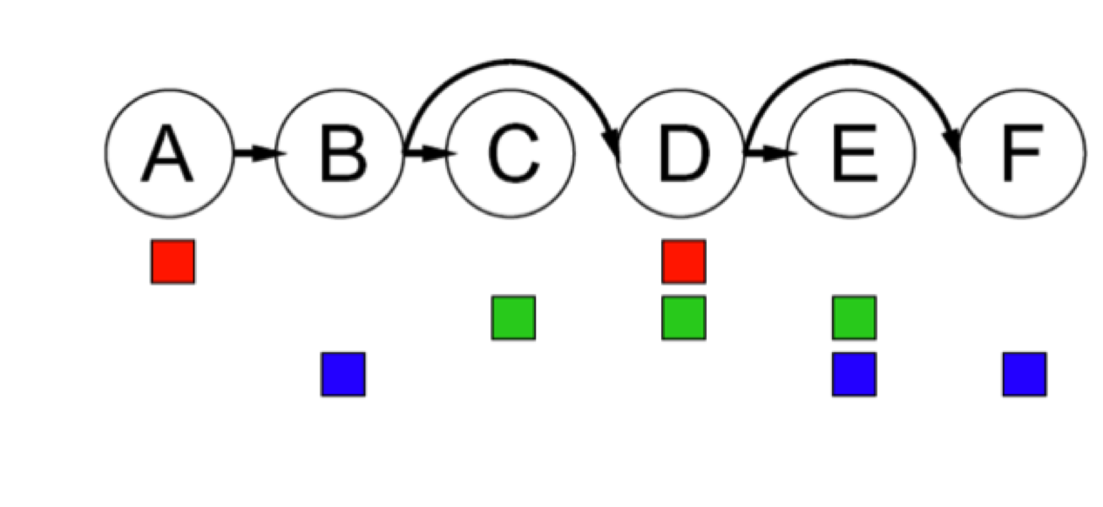


Conclusion
Future Work
Key Takeaways
Hybrid heuristics combining multiple CSP solving strategies
Map Coloring Problem is an excellent example of a CSP
Combining Forward Checking and MRV Heuristic makes the solution more efficient
Machine learning for dynamic constraint handling
Significant reduction in search space and backtracking
Parallel processing for large-scale CSPs
Real-World Applications
The Power of CSPs
Scheduling
GIS
Exam timetables, resource allocation
Geographic mapping systems
Compilers
Network
Register allocation
Frequency assignment
"Constraint Satisfaction Problems provide a powerful framework for solving complex real-world problems through systematic constraint handling."

Slide 12










References
Key References
Datasets
Russell, S., & Norvig, P.
Artificial Intelligence: A Modern Approach.
(2022).
USA Adjacency Dataset - with adjacency constraints
Cornell University
USA States Map Dataset – States with adjacency constraints
Constraint Satisfaction Problems (CSP).
(2011).
Baig, A.
Gigali Map Datasets - Various geographic regions for coloring problems
Solving Map Coloring Problems Using CSPs.
(2023).
Documentation & Tools
Research Papers
Python Documentation
Forward Checking in Constraint Satisfaction Problems
NetworkX Library
Matplotlib
Minimum Remaining Values Heuristic for CSPs
Kaggle Datasets

Slide 13
Thank You

